Slide 1
BIO Business Solutions®
bio.org/save

Slide 2
About
BIO Business Solutions helps 4,700 companies save over $705 million, making BBS the largest cost-savings program for the life sciences industry
Eligible to all BIO and participating state affiliates members
BIO does the due diligence on all supplier companies to ensure:
Vetted and qualified products and services
Favorable pricing and term agreements for members
Benefits of participation
Become part of a collective group with significant purchasing power
Seamlessly access savings and terms (the negotiation, follow up, etc. is done by BIO)
Help and support BIO and state affiliates’ policy priorities

Slide 3
Who Can Save
R&D life science companies
Life science companies without an in-house lab operation
Virtual labs
Start-ups
Technology companies
Companies that provide services to biotech companies
Companies that partner with CROs for research activities
Subsidiary of a company headquartered outside the US

Slide 4
Lab & Facilities
Packaged/bulk gas, Airgas
Refurbished lab equipment, ALT
Lab supplies, Avantor (VWR)
Waste removal, Clean Harbors
Microscope Systems, Nikon
Garments & Cleanroom, Unifirst

Slide 5
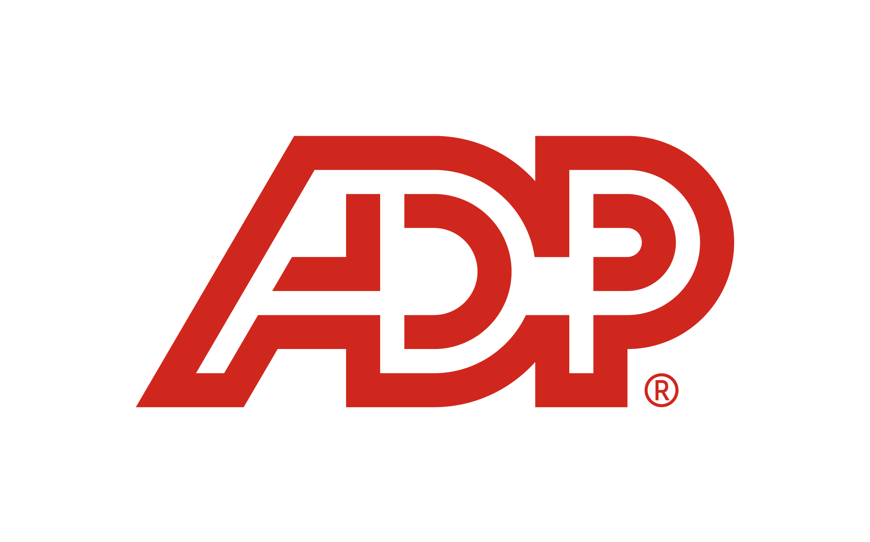
HR & Insurance
All-in-one HR, ADP
R&D Tax Credits, ADP
Compensation surveys, Workforce benchmarking, Aon
D&O, Executive Liability, and Cyber insurance, Aon
Business, Property & Casualty, Clinical Trial insurance, Chubb

Slide 6
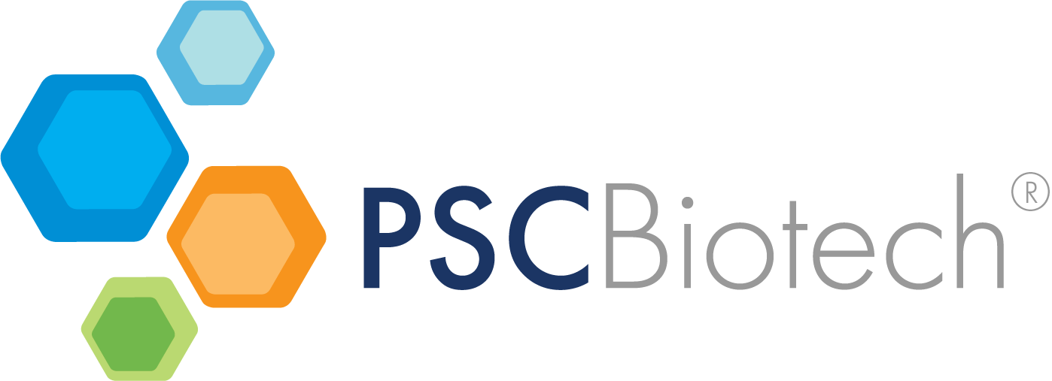
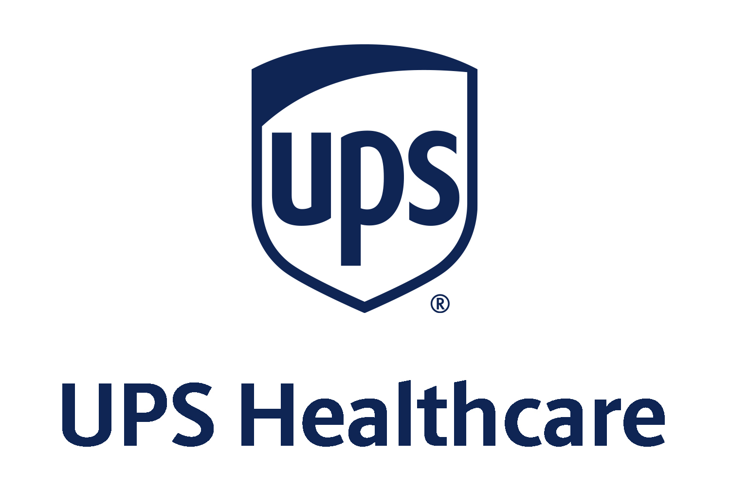
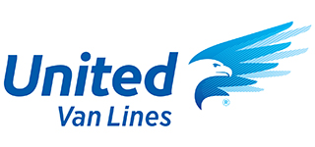
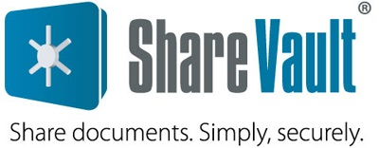
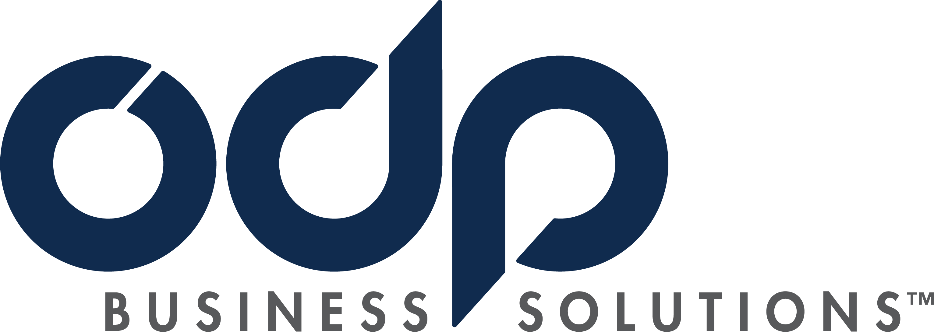
Everyday Business Services
Corporate credit card, expense, and travel management, Brex
Office supplies, printing, ODP Business Solutions
(formerly Office Depot)
FDA/regulatory consulting services, PSC Biotech
Quality management software, PSC Software
Secure document sharing, ShareVault
Office and employee relocation, United Van Lines
Shipping services, UPS Healthcare

