Slide 1
Accelerating Development through Sponsorship

Slide 2
Desired Outcomes
Retain and develop top female talent
Demonstrate commitment to diversity in senior-level positions across the organization
Accelerate exposure of top female talent in alignment with objectives
Create professional development opportunities
Notes:
Gina to review background and desired pilot outcomes

Slide 3
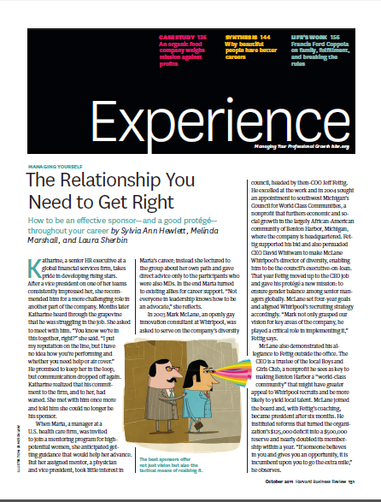
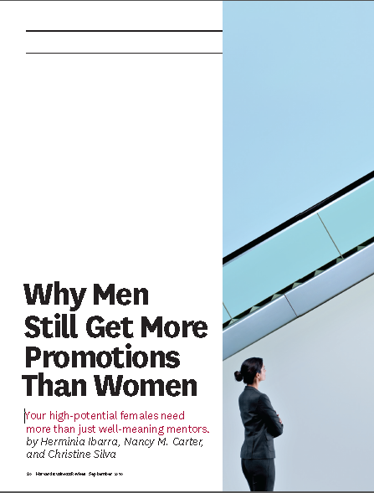
Pre-Read Discussion
What resonated with you from the pre-reads?

Slide 4
What is Sponsorship?
In a nutshell, two things:
Advocating for a sponsee (protégé)
Taking responsibility for advancing/developing/preparing
-From “The Relationship You Need to Get Right”, Harvard Business Review (October 2011) by Sylvia Ann Hewlett, Melina Marshall, and Laura Sherbin

Slide 5
Who’s Sponsored You?
Recall someone who’s sponsored you…
How did this individual impact your career trajectory?
How was their support different from that of a mentor or a coach?
Notes:
Small group activity in trios or pairs.

Slide 6
The Sponsor Effect: Satisfaction with Advancement
Individuals who are most satisfied with their rate of advancement are individuals with sponsors.
-Based on research conducted by the Center for Talent Innovation (CTI)
Notes:
CTI research has shown “…that individuals who are most satisfied with their rate of advancement are individuals with sponsors. Fully 70% of sponsored men and 68% of sponsored women feel they are progressing through the ranks at a satisfactory pace, compared to 57% of their unsponsored peers.”
“That translates into a ‘sponsor effect’ of 25% for men and 19% for women.”
-From pp. 22-23, Forget a Mentor, Find a Sponsor by Sylvia Ann Hewlett

Slide 7
The Sponsor Effect: Women's Career Trajectory
Sponsored mothers are 27% more likely to ‘stay in the game.’
-Based on research conducted by the Center for Talent Innovation (CTI)
Notes:
“The Center for Talent Innovation (CTI) has found that sponsors affect women’s career trajectory even more profoundly than men’s in at least one respect: 85% of mothers (employed full-time) who have sponsors stay in the game, compared to only 58% of those going it alone. That’s a sponsor effect of 27%.”
“The sponsor effect on professionals of color is even more impressive. Minority employees are 65% more likely than their unsponsored cohorts to be satisfied with their rate of advancement.”
-From p. 23, Forget a Mentor, Find a Sponsor by Sylvia Ann Hewlett

Slide 8
Mentorship vs. Sponsorship
Mentors and sponsors impact our careers differently:
A Mentor…
Can sit at any level in the organization
Provides emotional support, improvement feedback, and other advice
Serves as a role model
Helps a mentee learn to navigate corporate politics
Strives to increase a mentee’s sense of competence and self-worth
Focuses on mentee’s personal and professional development
-From “Why Men Still Get More Promotions Than Women”, Harvard Business Review (September 2010) by Herminia Ibarra, Nancy M. Carter, and Christine Silva

Slide 9
Mentorship vs. Sponsorship
Mentors and sponsors impact our careers differently:
A Sponsor…
ACTIVELY ADVOCATES: Advocates for protégé’s next promotion; speaks up when appropriate, calls in favors when necessary
PROVIDES SUPPORT (‘AIR COVER’): Protects protégé from negative publicity or damaging contact with other senior executives
MAKES CONNECTIONS: Makes connections to other senior leaders
EXPANDS PROTÉGÉ’S SELF-PERCEPTION: Expands protégé’s perception of their own skills and capabilities through feedback
IDENTIFIES OPPORTUNITIES FOR EXPOSURE: Ensures protégé is considered for promising opportunities and challenging assignments; advises on executive presence
-Adapted from “The Relationship You Need to Get Right”, HBR (October 2011) by Sylvia Ann Hewlett, Melina Marshall, and Laura Sherbin; and “Why Men Still Get More Promotions Than Women”, HBR (September 2010) by Herminia Ibarra, Nancy M. Carter, and Christine Silva.

Slide 10
What does a protégé do?
Can be trusted
Contributes 110% (Performance)
Covers their sponsor's back (Loyalty)
Promotes their sponsor's legacy
Allows a sponsor to shape the next generation of leaders
-From “The Relationship You Need to Get Right”, Harvard Business Review (October 2011) by Sylvia Ann Hewlett, Melina Marshall, and Laura Sherbin

Slide 11
Protégé Action Plan
Communicate regularly
In between quarterly meetings, keep your executive sponsor apprised of what's happening with your career (successes and challenges)
Signal that you’re a contributor
Find out what’s important to your executive sponsor’s legacy and help support his/her efforts
Read Hewlett’s (Forget a Mentor) Find a Sponsor

Slide 12
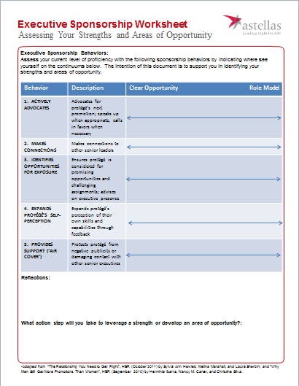
Skill Assessment
Assess Your Proficiency
Review the sponsorship behaviors and indicate where see yourself on the continuum
The intention of this document is to support your development as an Executive Sponsor

Slide 13
Sponsorship That Works: Program Success Factors
Clarify and Communicate Program Intent to Sponsors and Protégés
Establish Matches Based on Program Goals
Coordinate Efforts and Involve Direct Supervisors
Train Sponsors on the Complexities of Gender and Leadership
Hold Sponsors Accountable
Measure Results
-From “Why Men Still Get More Promotions Than Women”, Harvard Business Review (September 2010) by Herminia Ibarra, Nancy M. Carter, and Christine Silva

Slide 14
Leader Action Plan
Reach out to your Protégé
Let them know you’re looking forward to working with them (template to be provided)
Schedule an introductory meeting with you protégé in the next 45 days
Discuss your respective backgrounds, career goals, and how you will work together
Review the key behaviors from your worksheet
Leverage your strengths; seek support as needed for opportunities

Slide 15
BUILD Executive Sponsorship Pilot of Top Female Talent
Definition: Develop or unleash the talent of Top Female Talent within the organization;
Expected Business Impact: Retention and development of top female talent, demonstrated commitment to diversity in senior level positions across development organization through sponsorship; accelerated development and exposure of top female talent in alignment to create professional development opportunities

Slide 16
Executive Sponsorship Expectations
Sponsorship: active support by someone appropriately placed in the organization who has significant influence on decision-making processes or structures and who is advocating for, protecting, and fighting for the career advancement of an individual.
An influential sponsor can propel a female protégé to the top of a list of candidates or even eliminate the list.
How does sponsorship achieve these results?
Prepares protégés for the complexities of new roles and assignments by:
offering advice specific to a role, position or assignment for which the sponsor is recommending them
helping protégés determine exactly where, when and how to make strategic contributions
Helps mitigate perceived risk in placing someone in a developmental role
Helps protégés recognize the value-add of assignments and projects to their career
Helps protégés develop skills that support advancement, particularly those skills needed to be successful at the next level vertically
Differentiates decisions at the top, where fewer positions are available and the competition is greater
Helps women navigate the “double bind” where women who advocate for themselves can be penalized.

