Slide 1
Biotechnology Innovation Organization (BIO) Overview
Largest advocacy association representing the Life Sciences Community, including:
Member companies, state biotechnology groups, academic and research institutions, and related organizations
Background: Founded in 1993 as a non-profit in Washington, DC.
President & CEO, John Crowley
Serve: Emerging, health, industrial and environmental, and food/agriculture companies
BIO is committed to speaking up for the millions of families around the globe who depend upon our success, driving a revolution that aims to cure patients, protect our climate, and nourish humanity.
Access:
Policy—legislative, regulatory, advocacy, and legal
Business—access to capital, partnering, and savings
Public Opinion—communications, opinion, and marketing

Slide 2
BIO Business Solutions® - A Membership Benefit
The largest cost-savings program for the life sciences industry helping over 4,700 companies save more than $705 M
Eligible to all BIO and participating state affiliates members
BIO does the due diligence on all suppliers to ensure:
Vetted and qualified products and services
Favorable pricing and term agreements for life science association members
Benefits of participation
Watch your purchasing power grow by tapping into the pooled buying power of thousands of life science companies
Seamlessly access savings and terms (term negotiations, follow up, etc. is done by BIO)
Help and support the policy priorities of BIO and state associations

Slide 3
BBS by the Numbers
$830 M
$633 M
TOTAL ANNUAL SPEND
AGGREGATE SAVINGS IN 2023
4,600
6,090
COMPANIES PARTICIPATING
BBS PROGRAMS USED
AstraZeneca, Biogen, BioMarin, Bristol Myers Squibb, Genentech, Gilead Sciences, GSK, Incyte, Lonza, Merck, Moderna, Novartis, Novo Nordisk, Pfizer, Regeneron, Sangamo, Vertex, and more.
Participating Companies

Slide 4
Everyday Business Services
Corporate credit card, Brex
Office supplies, ODP Business Solutions
(formerly Office Depot)
Professional services & consulting, PSC Biotech
Quality management software, PSC Software
Secure document sharing, ShareVault
Office and employee relocation, United Van Lines
Shipping Services, UPS Healthcare

Slide 5
Lab & Facilities
Packaged/bulk gas, Airgas
Refurbished lab equipment, ALT
Lab supplies, Avantor (VWR)
Waste removal, Clean Harbors
Microscope Systems, Nikon
Garments & Cleanroom, Unifirst

Slide 6
HR & Insurance
All-in-one HR, ADP
R&D Tax Credits, ADP
Workforce consulting, Aon
Executive Liability and Cyber insurance, Aon
Business, Property & Casualty, Clinical Trial insurance, Chubb
Small group health plans, Mercer

Slide 7
Who Can Save
R&D life science companies
Life science companies without an in-house lab operation
Virtual labs
Start-ups
Technology companies
Companies that provide services to biotech companies
Companies that partner with CROs for research activities
Subsidiary of a company headquartered outside the US

Slide 8
Endorsing State Life Science Associations

Slide 9
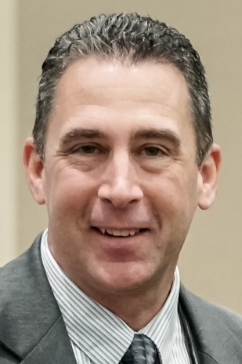
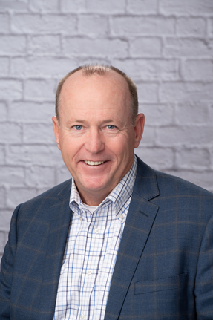
BIO Business Solutions® BD Team Coverage
Jeff Vallerga
480-543-9423 jvallerga@bio.org
Neil Lynch
202-365-6745
nlynch@bio.org
Jim Seymour
845-239-3325
jseymour@bio.org

Slide 10
BD team provides
Provide vetted leads to the partners
Work and connects partners with state affiliate organization network to identify targets account
Leverage relationship with VWR to gain access into target accounts for other BBS supplier partners
Leverage existing BIO or state affiliate member relationship to provide access to target accounts
Follow up to help close pending opportunities
Joint Sales call

