Slide 1

Biotechnology Innovation Organization (BIO) Overview
Largest advocacy association representing the Life Sciences Community, including:
Member companies, state biotechnology groups, academic and research institutions, and related organizations
Background: Founded in 1993 as a non-profit in Washington, DC.
President & CEO, John Crowley
Serve: Emerging and health companies
BIO is committed to speaking up for the millions of families around the globe who depend upon our success, driving a revolution that aims to cure patients.
Access:
Policy—legislative, regulatory, advocacy, and legal
Business—access to capital, partnering, and savings
Public Opinion—communications, opinion, and marketing

Slide 2
BIO Business Solutions® - A Membership Benefit
The largest cost-savings program for the life sciences industry helping over 4,700 companies save more than $700 M
Eligible to all BIO and participating state affiliates members
BIO does the due diligence on all suppliers to ensure:
Vetted and qualified products and services
Favorable pricing and term agreements for life science association members
Benefits of participation
Watch your purchasing power grow by tapping into the pooled buying power of thousands of life science companies
Seamlessly access savings and terms (term negotiations, follow up, etc. is done by BIO)
Help and support the policy priorities of BIO and state associations

Slide 3




BBS by the Numbers
$830 M
$700 M
TOTAL ANNUAL SPEND
AGGREGATE SAVINGS
4,700
6,000
COMPANIES PARTICIPATING
BBS PROGRAMS USED
AstraZeneca, Biogen, BioMarin, Bristol Myers Squibb, Genentech, Gilead Sciences, GSK, Incyte, Lonza, Merck, Moderna, Novartis, Novo Nordisk, Pfizer, Regeneron, Sangamo, Vertex, and more.
Participating Companies

Slide 4







Lab & Facilities
Packaged/bulk gas, Airgas
Refurbished lab equipment, ALT
Lab supplies, Avantor (VWR)
Waste removal, Clean Harbors
Microscope systems & contract imaging services, Nikon
Equipment service contract consolidation, SU Group
Cleanroom and First Aid Safety, Unifirst

Slide 5



HR & Insurance
All-in-one HR, ADP
R&D Tax Credits, ADP
Compensation surveys, Workforce benchmarking, Aon
D&O, Executive Liability, and Cyber insurance, Aon
Business, Property & Casualty, Clinical Trial insurance, Chubb

Slide 6








Corporate Services
C-Suite executive consulting & placement, BiotechExec
Corporate credit card & expense management, Brex
Business travel management, Corporate Traveler
Office supplies, printing, ODP Business Solutions
(formerly Office Depot)
FDA/regulatory consulting services, PSC Biotech
Quality management software, PSC Software
Secure document sharing, ShareVault
Office and employee relocation, United Van Lines
Shipping & logistics, UPS Healthcare

Slide 7
Who Can Save
R&D life science companies
Life science companies without an in-house lab operation
Virtual labs
Start-ups
Technology companies
Companies that provide services to biotech companies
Companies that partner with CROs for research activities
Subsidiary of a company headquartered outside the US

Slide 8














































Endorsing State Life Science Associations

Slide 9
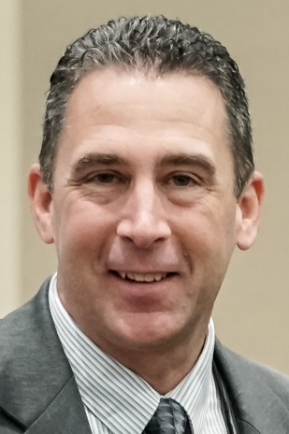
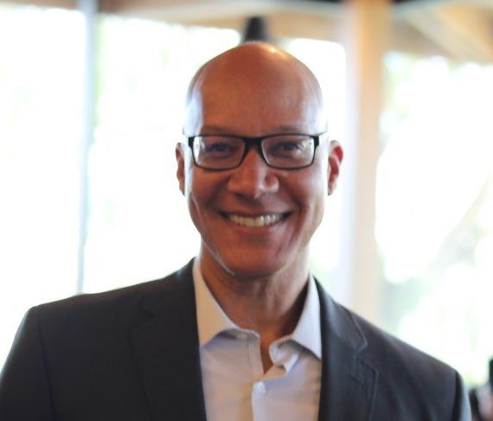
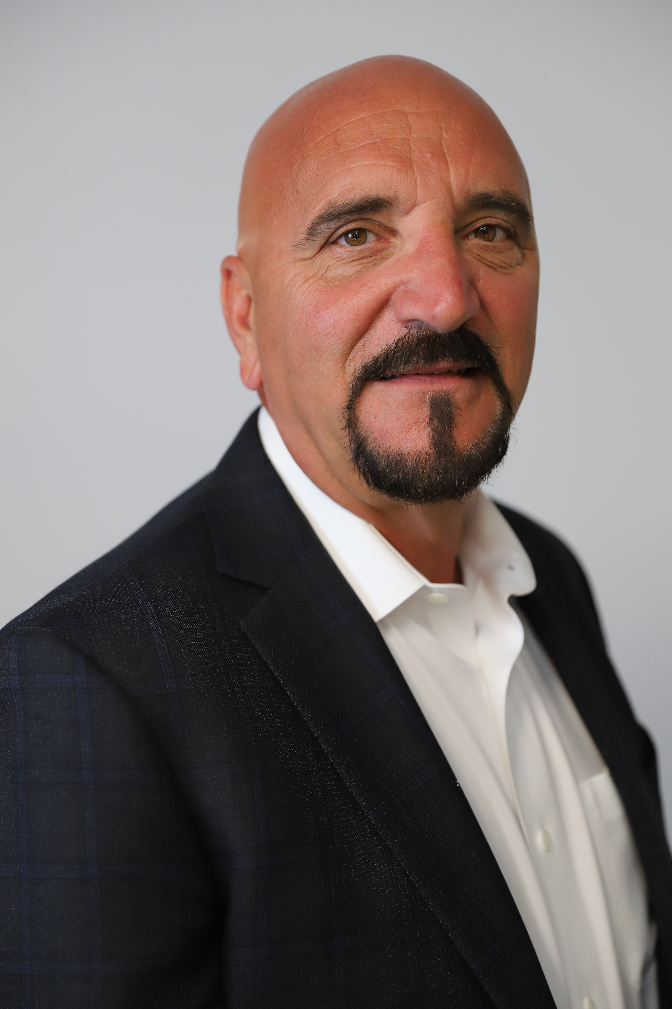
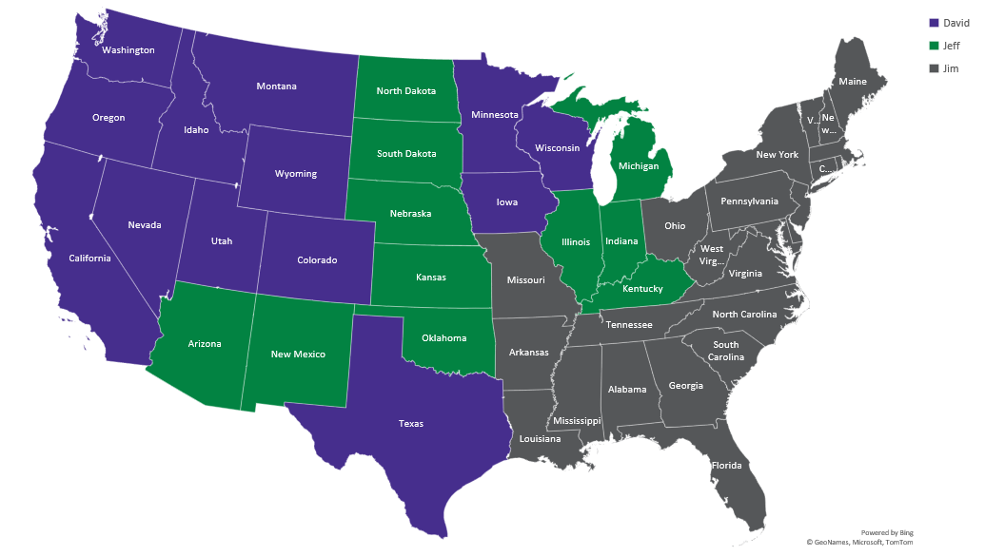
BIO Business Solutions® BD Team Coverage
Jeff Vallerga
480-543-9423 jvallerga@bio.org
David Mosley
415-350-9324
dmosley@bio.org
Jim Seymour
845-239-3325
jseymour@bio.org

