Slide 1











Health Policy & Programs
Empowering innovation, advocacy, and access; dedicated focus areas on access and reimbursement, infectious disease and vaccines.
Emerging Companies & Economic Growth
Fostering capital formation and policies
that help companies grow, advance science,
and ultimately develop new products.
About the Biotechnology
Innovation Organization (BIO)
Science & Regulatory Affairs
Focused on modernizing agency regulatory processes so that cutting-edge science and technology can prosper.
Communications
Committed to outstanding storytelling, supporting policy and advocacy through communication, and executing a strategy that conveys biotechnology’s critical importance.
BIO is the premier biotechnology advocacy organization representing biotech companies, industry leaders, & and state biotech associations in the United States and more than 35 countries around the globe.
BIO members range from biotech start-ups to some of the world’s largest biopharmaceutical companies – all united by the same goal: to develop medical and scientific breakthroughs that prevent and fight disease, restore health, and improve patients’ lives.
BIO also organizes the BIO International Convention and a series of annual conferences that drive partnerships, investment, and progress within the sector.
Federal Government Affairs
Leading advocacy efforts with the federal government to advance policies that enable science and improve lives.
National Security & International Affairs
Ensuring that biotechnology is seen as a U.S. national security priority.
State Government Affairs
Advancing state legislation and strengthening our relationship with the Council of State Bioscience Associations to move our industry forward.
Business Operations
Dedicated to convening the industry, growing membership, and providing the resources and infrastructure that enable the pursuit of BIO’s mission
Patient Advocacy & Alliance Development
Driving strategic engagement with patient advocacy groups and coalitions to enable patient centric policy members’ patient advocacy and engagement efforts.
Legal
Trusted advisors and experienced counsel helping ensure compliance and governance.

Slide 2
BIO Business Solutions® - A Membership Benefit
The largest cost-savings program for the life sciences industry helping over 4,700 companies save more than $700 M
Eligible to all BIO and participating state affiliates members
BIO does the due diligence on all suppliers to ensure:
  Vetted and qualified products and services
  Favorable pricing and term agreements for life science association members
Benefits of participation
  Watch your purchasing power grow by tapping into the pooled buying power of thousands of life science companies
  Seamlessly access savings and terms (term negotiations, follow up, etc. is done by BIO)
  Help and support the policy priorities of BIO and state associations

Slide 3
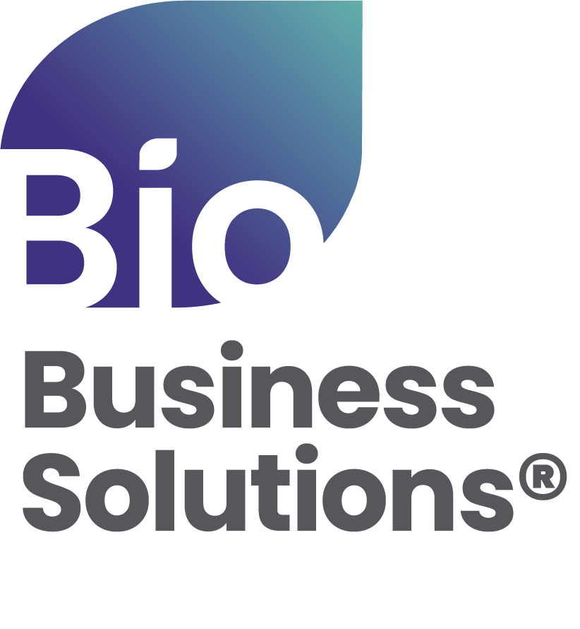
BBS by the Numbers
$750 M
$600 M
TOTAL ANNUAL SPEND
AGGREGATE SAVINGS
4,500
6,000
COMPANIES PARTICIPATING
BBS PROGRAMS USED
AstraZeneca, Biogen, BioMarin, Bristol Myers Squibb, Genentech, Gilead Sciences, GSK, Incyte, Lonza, Merck, Moderna, Novartis, Novo Nordisk, Pfizer, Regeneron, Sangamo, Vertex, and more.
Participating Companies

Slide 4







Lab & Facilities
Packaged/bulk gas, Airgas
Refurbished lab equipment, ALT
Waste removal, Clean Harbors
Microscope systems & contract imaging services, Nikon
Equipment service contract consolidation, SU Group
Cleanroom and First Aid Safety, Unifirst
Lab supplies, VWR, part of Avantor

Slide 5



HR & Insurance
All-in-one HR, ADP
R&D Tax Credits, ADP
Insurance carrier for Business, Property & Casualty, Clinical Trial insurance, Chubb
Insurance broker for Executive Liability, Cyber, & Employee Benefits, NFP

Slide 6



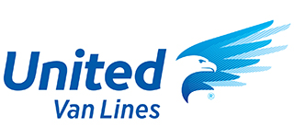




Corporate Services
C-Suite executive consulting & placement, BiotechExec
Corporate credit card & expense management, Brex
Business travel management, Corporate Traveler
Office supplies, printing, ODP Business Solutions
(formerly Office Depot)
FDA/regulatory consulting services, PSC Biotech
Quality management software, PSC Software
Secure document sharing, ShareVault
Office and employee relocation, United Van Lines
Shipping & logistics, UPS Healthcare

Slide 7
Who Can Save
R&D life science companies
Life science companies without an in-house lab operation
Virtual labs
Start-ups
Technology companies
Companies that provide services to biotech companies
Companies that partner with CROs for research activities
Subsidiary of a company headquartered outside the US

Slide 8




































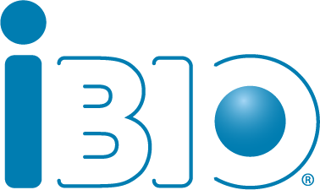









Endorsing State Life Science Associations

Slide 9
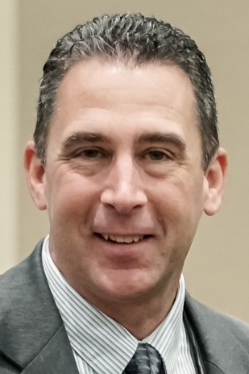

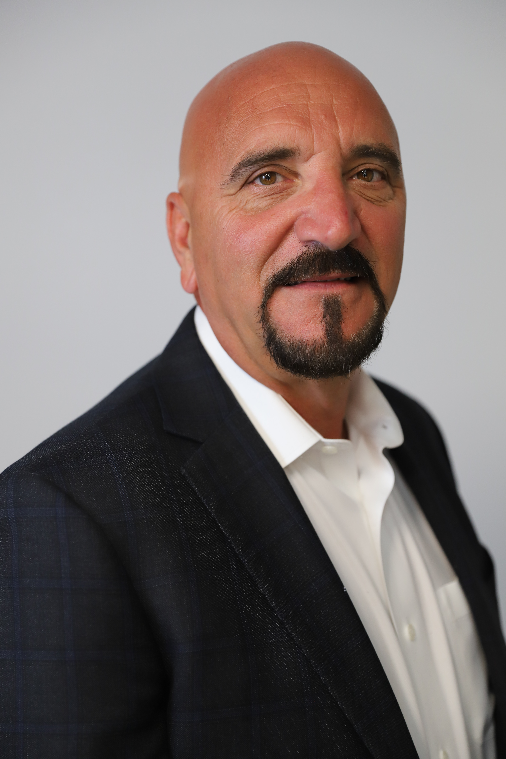
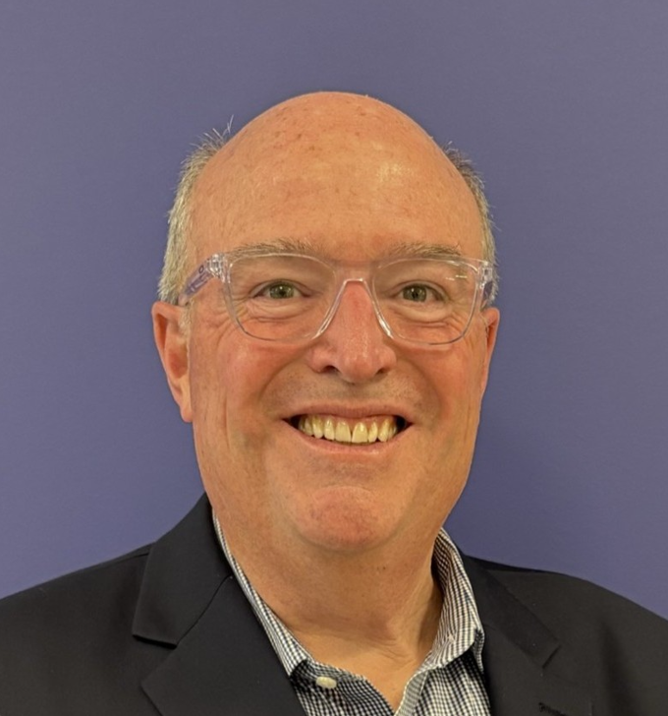
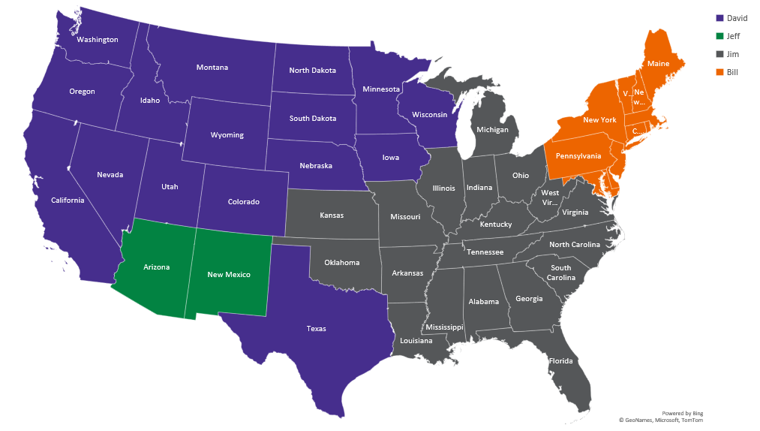
BIO Business Solutions® BD Team Coverage
Jeff Vallerga
480-543-9423 jvallerga@bio.org
David Mosley
415-350-9324
dmosley@bio.org
Jim Seymour
845-239-3325
jseymour@bio.org
Bill Wivell
202-450-0039
wwivell@bio.org

